Slide 1

Academic Year 2025 - 26
S6 MINI PROJECT
PHASE 1
PROJECT TITLE
RESULT PROCESSING SYSTEM

Slide 2
AIM & OBJECTIVES OF THE PROJECT
Aim
To design and develop a Result Processing System that enables efficient management, storage, analysis, and retrieval of student academic results through a secure and centralized digital platform using modern web technologies.
Objective
To provide role-based portals for administrators/staff and students.
To enable secure login using JWT authentication and role-based access control.
To allow administrators to create, update, and delete student accounts
To allow administrators to publish, edit, and delete semester results (Semester 1 to 8)
To enable students to view semester-wise results and track academic progress over time.
To implement automatic calculation of total, percentage, and grade from marks.

Slide 3
PROBLEM STATEMENT & PROPOSED SOLUTION
Problem Statement
In many institutions, student results are managed using manual methods or semi-digital systems such as spreadsheets or paper records. This leads to inefficiency, mismanagement of records, and delays in accessing academic performance data.
Objective
To develop a secure and user-friendly interface for role-based login and result access.
To implement an admin dashboard for efficient management of student accounts and semester results.
To design a centralized MongoDB database for structured and secure academic record storage.
To enable real-time result publishing and retrieval for improved transparency.
To implement JWT-based authentication for secure session handling and access control.

Slide 4
TECH STACK & ARCHITECTURE
The MERN stack (MongoDB, Express.js, React.js, Node.js) is selected for this project due to its scalability, flexibility, and full-stack JavaScript capability. React is used to build dynamic, route-based dashboards for both staff and students. Express.js with Node.js handles backend API requests and business logic. MongoDB, integrated using Mongoose, stores user and result data in a structured format.
User
React UI (Frontend)
Express.js API (Backend)
Response back to React UI
MongoDB (Database)

Slide 5
DB Schema & Entity Design
The database schema is designed to store user accounts, semester results, notifications, and analytical data in a structured and scalable manner.
Users
name
email
password (hashed)
role (staff / student)
roll_no
Results
roll_no
semester
subjects
total
percentage
grade
created_by
Notifications
user_id
message
isRead
createdAt
User → Result : One student can have multiple semester results (1 : N)
Admin (role-based user) → Result : Admin can create, update, and delete results
Result → Notification : Each published result generates notifications for students

Slide 6
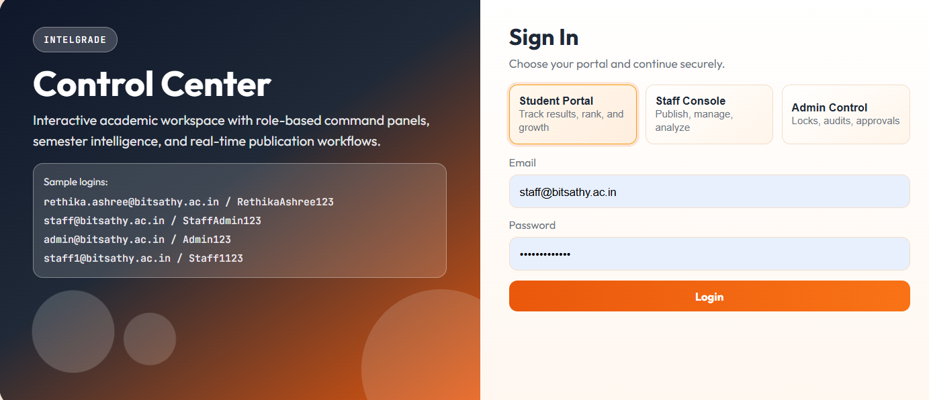
UI/UX WIREFRAMES & THEME
The UI/UX design focuses on simplicity, clarity, and usability. The application provides separate dashboards for administrators and students. The admin dashboard includes result management features, analytics panels, and filtering options.

Slide 7
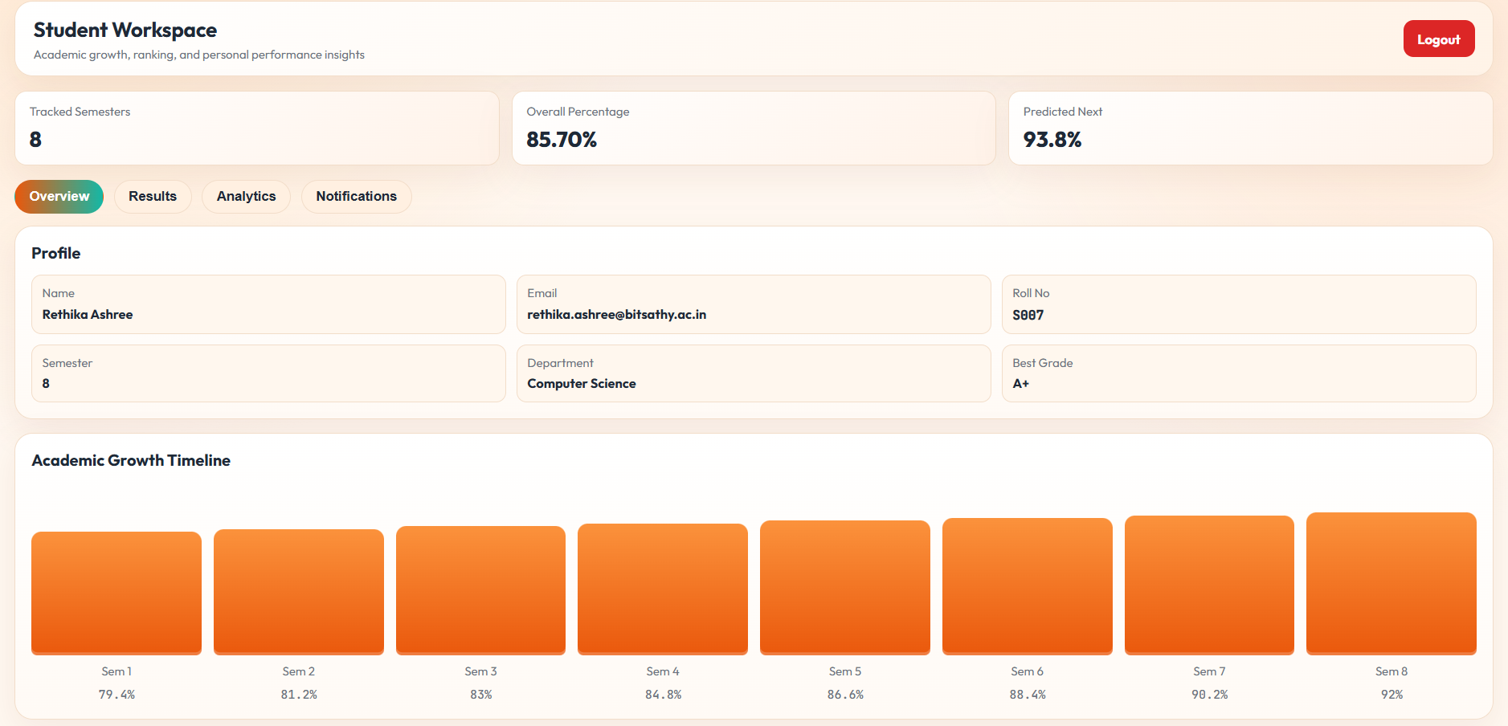
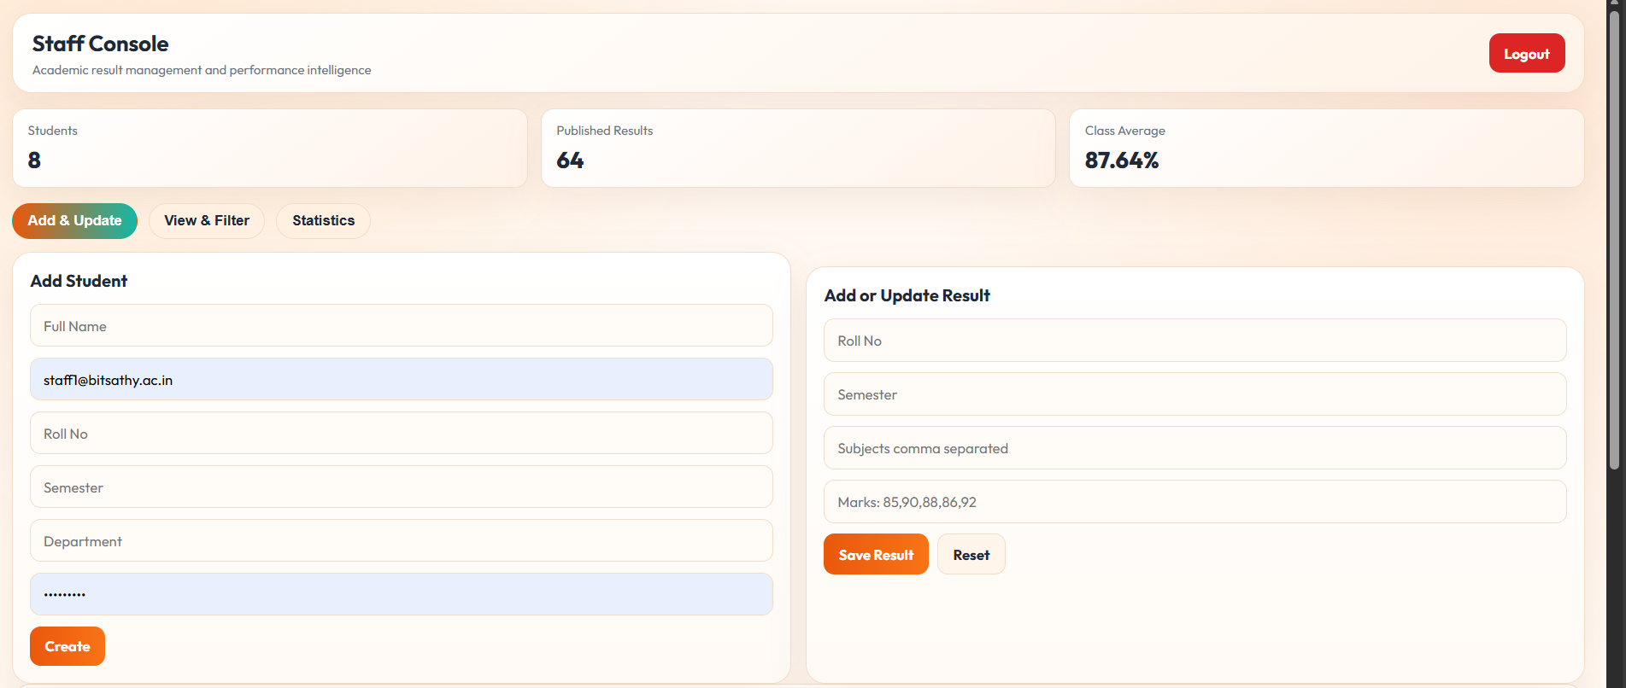
UI/UX WIREFRAMES & THEME

Slide 8
PROJECT BOILERPLATE SETUP
Project Boilerplate Setup includes:
Project setup includes initializing a GitHub repository, creating a client–server folder structure, installing required dependencies, configuring environment variables, and setting up essential configuration files such as .gitignore and README.md.
The system also includes an initialization route (/api/init) that seeds demo administrators, students, and multi-semester results for testing and development purposes.

Slide 9
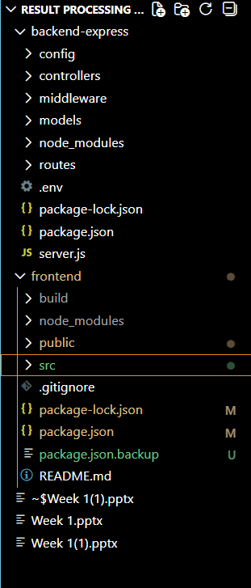
PROJECT BOILERPLATE SETUP
Project Boilerplate Setup :

Slide 10
GITHUB WORKFLOW & DOCUMENTATION
Repository is initialized with proper project structure
.gitignore is used to exclude unnecessary and sensitive files
main branch contains stable, production-ready code
develop branch is used for ongoing development
GitHub is used for version control and source code management
feature branches are created for new features
README Documentation Link :

